Slide 1
Statistics for Business Analytics
Notes:
https://www.superdatascience.com/podcast-application-geospatial-analytics-business-real-life/

Slide 2
Introduction
Continuous vs Discrete
What is a Distribution?
What is Standard Deviation?
Normal Distribution
Skewness
Mean, Median, Mode

Slide 3
Discrete variables - also called categorical variables - can only have a certain value from a limited set of values.
Continuous variables - also called numerical variables - can have any range of values. Sometimes continuous variables can have upper and/or lower bounds.
Sometimes a variable can be considered either continuous or discrete. The choice is up to the analyst and is based on the context of the variable within the business scenario.
Distribution – a probability distribution is a mathematical function that can be thought of as providing the probability of occurrence of different possible outcomes in an experiment.
The distribution of a discrete variable can be visualized using a histogram with probability on the y-axis and the categorical values on the x-axis. A continuous variable’s distribution is commonly visualized by a continuous function with probability on the y-axis and the range for the continuous variable’s values on the x-axis. The probability distribution of a continuous variable is referred to as a probability distribution function – pdf. With continuous variables, the area under the pdf between a lower and upper bound represents the probability that the continuous variable will take on a value somewhere between those bounds.

Slide 4

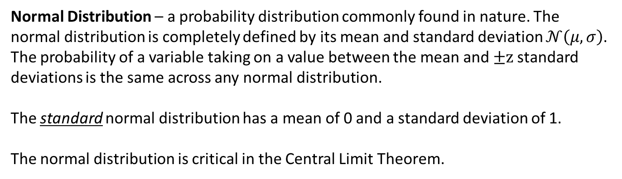
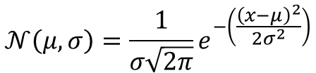
Standard Deviation – measures the spread of the distribution.
$$Variance=σ^{2}=\frac{\sum_{i=1}^{n}{{\left(x_{i}−\overline{x}\right)}^{2}}}{n}$$
$$Standard Deviation=σ=\sqrt{Variance}$$
Normal Distribution – a probability distribution commonly found in nature. The normal distribution is completely defined by its mean and standard deviation $𝒩\left(μ, σ\right)$. The probability of a variable taking on a value between the mean and $±z$standard deviations is the same across any normal distribution.
The standard normal distribution has a mean of 0 and a standard deviation of 1.
The normal distribution is critical in the Central Limit Theorem.
$$𝒩\left(μ, σ\right)=\frac{1}{σ\sqrt{2π}}e^{−\left(\frac{{\left(x−μ\right)}^{2}}{2σ^{2}}\right)}$$

Slide 5
Skewness – a distribution that not symmetric around the mean. A left (negative) skew and a fatter left-handed tail. A right (positive) skew has a fatter right-handed tail.
Mean – the average value of the continuous variable.
Median – the value such that 50% of the values of the continuous variable are less than the median and 50% of the values are greater than the median.
The median is not affected by outliers whereas outliers can significantly affect the mean.
Mode – the most frequent value in the distribution.
In a negatively skewed distribution, mode > median > mean
In a positively skewed distribution, mean > median > mode

Slide 6


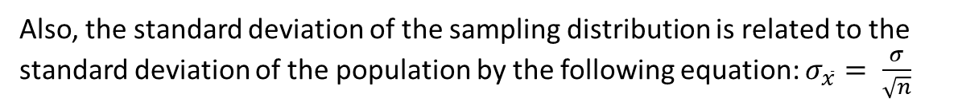
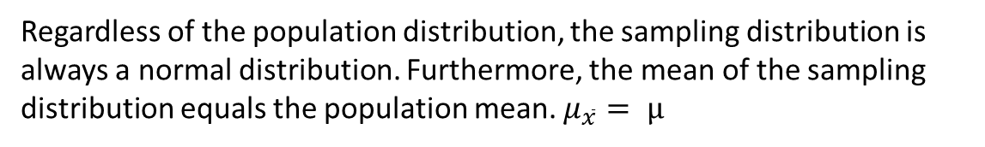
Central Limit Theorem
Population → parameters → N, μ, σ
Sample → statistics → n,$\overline{x}$, s
Sample statistics are used to estimate population parameters with a certain degree of confidence.
Sampling distribution is a collection of the means from each of a multitude of samples taken from the population.
Central Limit Theorem
Regardless of the population distribution, the sampling distribution is always a normal distribution. Furthermore, the mean of the sampling distribution equals the population mean. $μ_{\overline{x}}= μ$
Also, the standard deviation of the sampling distribution is related to the standard deviation of the population by the following equation: $σ_{\overline{x}}= \frac{σ}{\sqrt{n}}$
$$Z Score=\frac{\left(x−μ_{\overline{x}}\right)}{σ_{\overline{x}}}$$
Pick off probability for Z score probability table

Slide 7
Hypothesis Testing / Statistical Significance
Statistical Significance
Hypothesis Testing (a.k.a. z-test)
Steps
Rejection Region
Assumptions
Proportion Testing

Slide 8

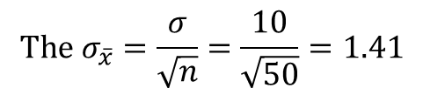
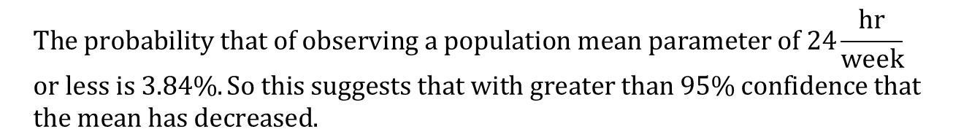
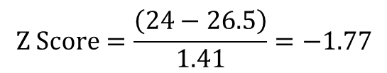
Hypothesis Testing Steps
Example – In 2015 millennials were watching 26.5 hours of TV per week with a standard deviation of 10 hours. Today you surveyed 50 millennials and found that they watch 24 hours of TV per week. Has the parameter decreased?
Step 1 – Correctly formulate the null hypothesis H₀ and alternate hypothesis H₁.
H₀ : The mean parameter has not decreased, i.e. $μ ≥26.5$
H₁ : The mean parameter has decreased, i.e. $μ <26.5$
Step 2 – Use the central limit theorem to see whether we can reject the null hypothesis.
$$The σ_{\overline{x}}=\frac{σ}{\sqrt{n}}=\frac{10}{\sqrt{50}}=1.41$$
$$Z Score=\frac{\left(24−26.5\right)}{1.41}=−1.77$$
$$p Value(Z Score=−1.77)=0.0384$$
$$The probability that of observing a population mean parameter of 24\frac{hr}{week} \\ or less is 3.84\%. So this suggests that with greater than 95\% confidence that \\ the mean has decreased.$$

Slide 9
Statistical Significance
Learning Example: The Coin Flip
In hypothesis testing we always start off assuming we live in the H₀ universe…
H₀ : The coin is a fair coin
H₁ : The coin is a not fair coin
The goal of hypothesis testing is to see whether we can reject the null hypothesis.
Rejection Region
If your confidence level is 95% then the P_{crit} = 5% = 0.05
For a P_{crit} = 5% = 0.05, the z_{crit} = -1.65
Assumptions
Sample is selected at random (you do not want to pick a biased sample)
Observations are independent
The population’s standard deviation is know OR the sample contains at least 30 observations

Slide 10
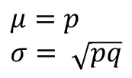
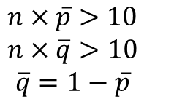
Proportion Testing
Learning Example: According to a 2016 survey, “58% of American households have tables”. You want to test the hypothesis (with 97% significance level) that only 58% of American households have tablets. You survey 100 random households and find that 73 of them had tablets.
H₀ : 58% or fewer households have tablets, i.e. p $≤58\%$
H₁ : More than 58% of households have tablets, i.e. p > 58%
The sample has to meet the following criteria:
$$n×\overline{p}>10$$
$$n×\overline{q}>10$$
$$\overline{q}=1−\overline{p}$$
Proportion test formulas:
$$μ=p \\ σ= \sqrt{pq}$$

